Slide 1

Multiplication Table Generator in C++
Welcome to our presentation on creating a Multiplication Table Generator in C++. In the following cards, we'll explore the benefits of this program, define the requirements, and walk through the design and implementation process.

Slide 2
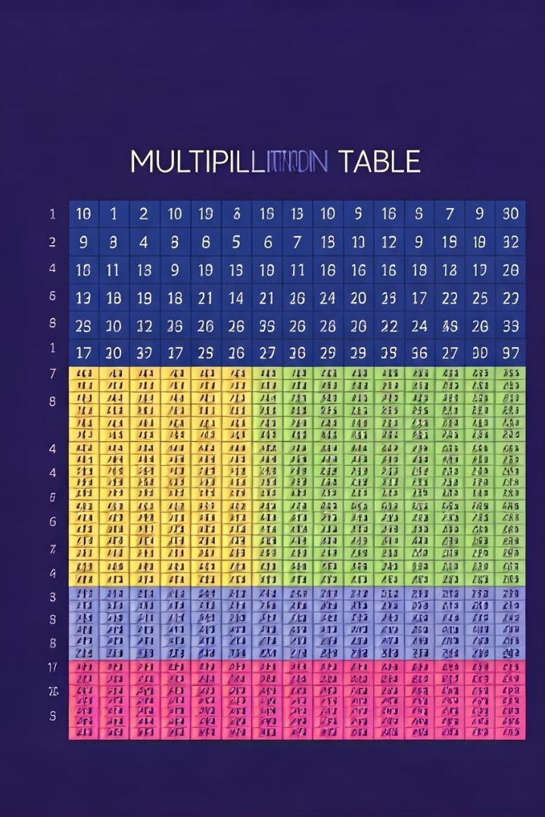
Introduction to Multiplication Tables
Multiplication tables are a fundamental tool for learning and mastering basic arithmetic. They provide a structured way to visualize and understand the relationships between numbers, making math more accessible and engaging.

Slide 3

Why Create a Multiplication Table Generator?
1
Personalized Learning
2
Effortless Accessibility
3
Improved Efficiency
Generating custom multiplication tables allows users to focus on the specific range of numbers they need to practice, tailoring the learning experience.
A digital generator eliminates the need for physical multiplication charts, making the resource readily available on any device.
Automating the process of creating multiplication tables saves time and reduces the risk of manual errors.

Slide 4
Defining the Program Requirements
User Inputs
Output Format
The program should accept user input for the range of numbers to be included in the multiplication table.
The generated multiplication table should be displayed in a clear, easy-to-read format, with rows and columns organized by the input numbers.

Slide 5

Designing the Program Structure
Planning
User Interface
Outline the core functionality and map out the program's structure, considering the user inputs and desired outputs.
Create a user-friendly interface that makes it easy for users to input the desired range and view the results.
1
2
3
Algorithm Design
Develop the core logic for generating the multiplication table, ensuring it's efficient and scalable.

Slide 6
Implementing the Multiplication Table Algorithm
Nested Loops
Formatting Output
Use a pair of nested loops to iterate through the rows and columns of the multiplication table, calculating the results for each cell.
Ensure the output is neatly formatted, with consistent spacing and alignment between the rows and columns.

Slide 7

Handling User Inputs and Outputs
Input Validation
Output Display
Implement input validation to ensure the user enters valid numbers within the expected range, providing clear error messages if necessary.
Decide how to best present the generated multiplication table, whether it's printing to the console, saving to a file, or displaying in a graphical user interface.
Error Handling
Anticipate and handle any potential errors or edge cases that may arise during the program's execution, providing helpful feedback to the user.

Slide 8


Enhancing the Generator with Additional Features
Customization
Printing
Allow users to customize the appearance and formatting of the multiplication table, such as changing the font, colors, or layout.
Implement the ability to print or save the generated multiplication table in a format that can be easily shared or distributed.
Dynamic Updates
Explore opportunities to make the generator more dynamic, such as allowing users to update the table in real-time or save their customized versions.

Slide 9
Conclusion and Next Steps
Recap
1
In this presentation, we've covered the key aspects of creating a Multiplication Table Generator in C++, from defining the requirements to implementing the core functionality and enhancing the program.
Next Steps
2
Consider opportunities to further improve the generator, such as adding support for different mathematical operations, creating a web-based version, or integrating it with educational platforms.
Closing Thoughts
By building this multiplication table generator, you'll not only create a useful tool but also gain valuable experience in algorithm design, user interface development, and C++ programming.
3

